Slide 1
Lecture 24 – Operator and Function Overloading
Operator and function overloading
Kok-Seng Wong | 2021

Slide 2

Motivation example
[source]

Slide 3
Learning outcomes
Upon the completion of this lecture, students will be able to:
explain how to use operator and function overloading in Python object-oriented programming.
understand how to override built-in methods in Python.
Understand the basic concept of Encapsulation and Polymorphism in OOP.

Slide 4
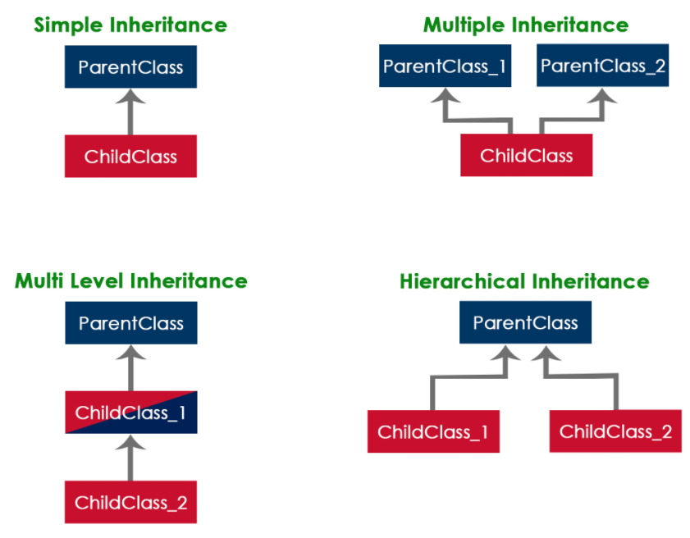
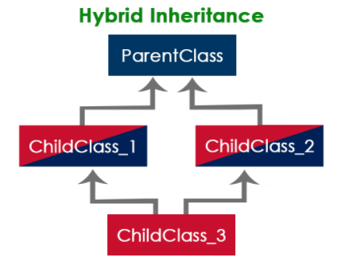
Inheritance (review)
[source]

Slide 5
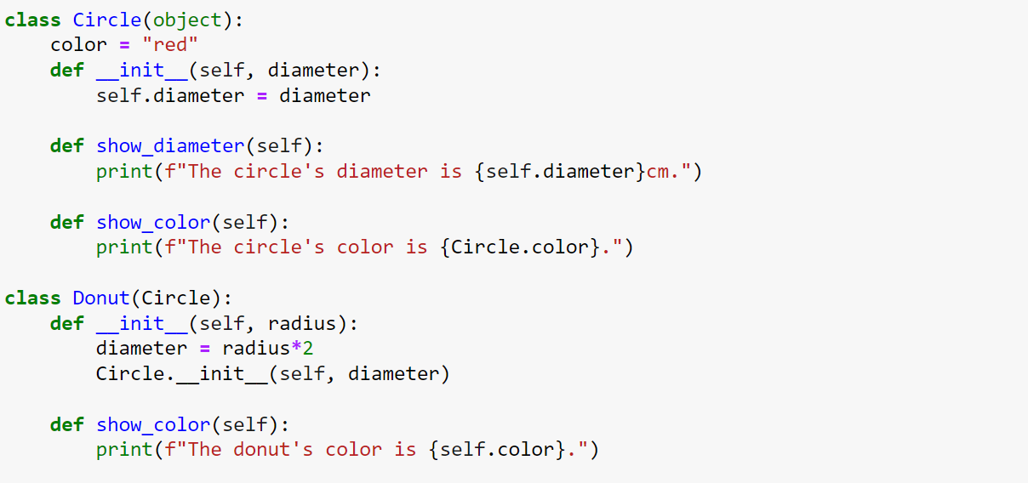
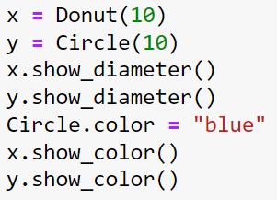
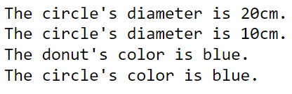
Review example

Slide 6
Operator overloading

Slide 7
overloading
Overloading refers to the ability of a function or an operator to behave in different implementations.
Depending on the parameters that are passed to the function, or the operands that the operator acts on.

Slide 8


Operator overloading
“+” operator has two interpretations.
Addition Operator: to add two numbers
Concatenation Operator: to concatenate two strings
‘+’ operator is overloaded by int class and str class

Slide 9
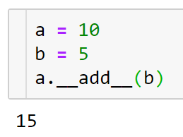
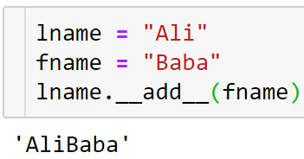
Operator overloading
To change the default behavior of “+” operator, we need to define the corresponding special method __add__()

Slide 10
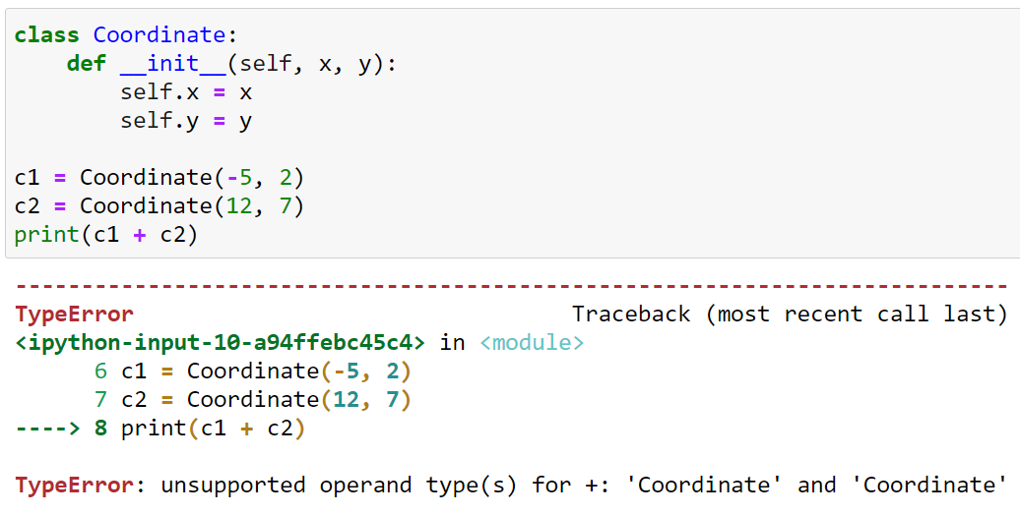
Operator overloading: example 1
Output?

Slide 11
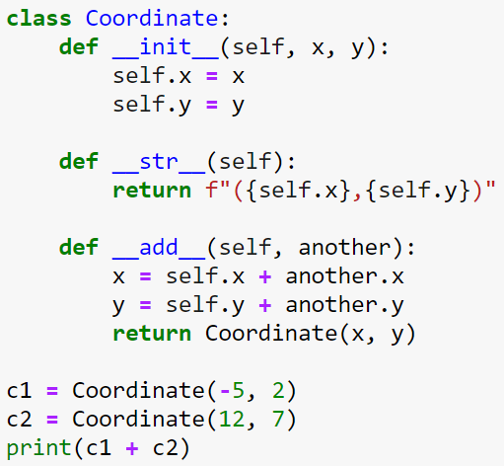
Operator overloading: example 1
Output?
Python calls c1.__add__(c2)

Slide 12
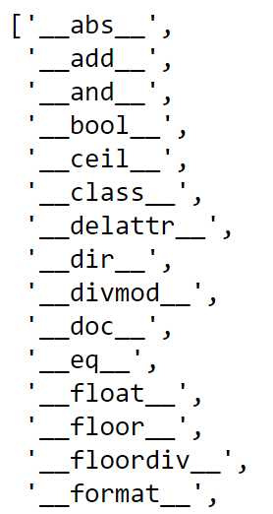
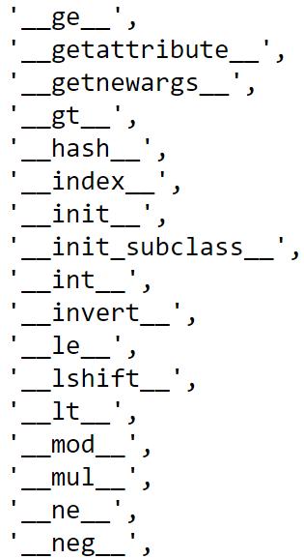
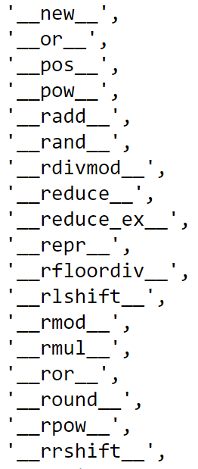
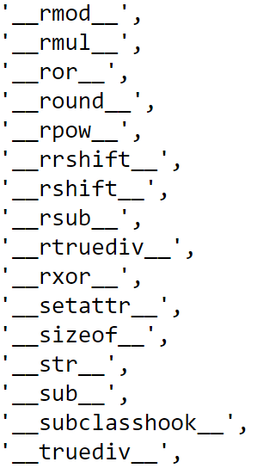
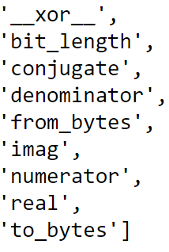
Python dir() function
dir()function: returns all properties and methods of the specified object, without the values.
dir(object)

Slide 13
Common operators to overload
Operator | Method
+ | __add__(self, other)
- | __sub__(self, other)
* | __mul__(self, other)
/ | __truediv__(self, other)
% | __mod__(self, other)
< | __lt__(self, other)
<=< code> | __le__(self, other)
== | __eq__(self, other)
!= | __ne__(self, other)
> | __gt__(self, other)
>= | __ge__(self, other)

Slide 14
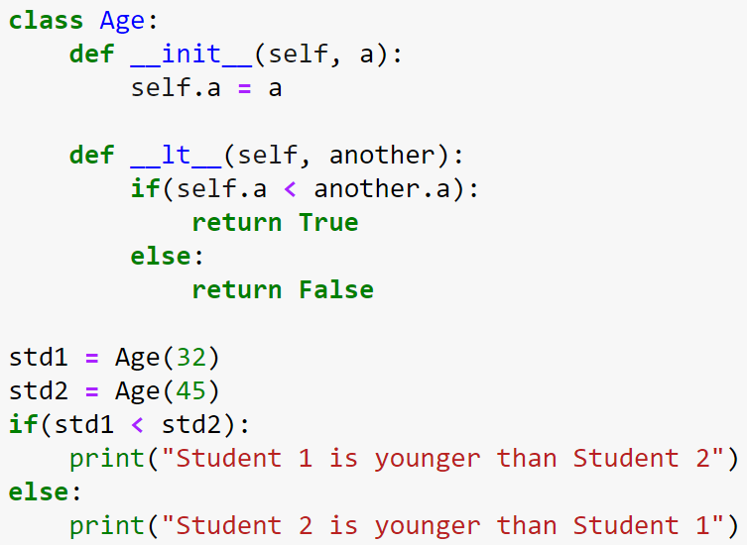
Operator overloading: example 2
What is the output?

Slide 15
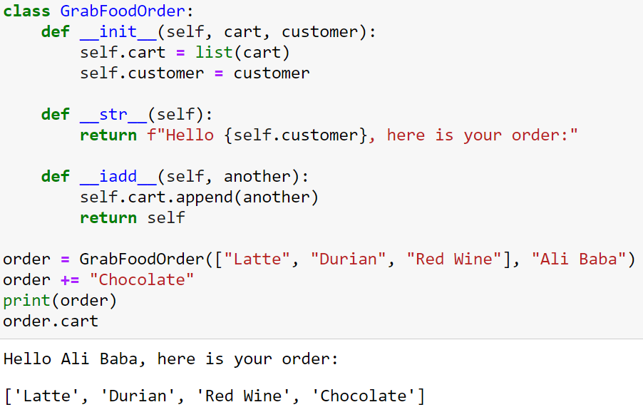
Operator overloading: example 3
Make changes directly to the self argument and return the result
Corresponding to += operator

Slide 16
Function overloading

Slide 17
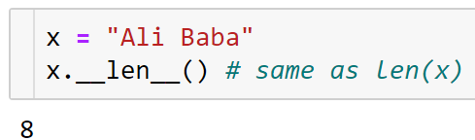
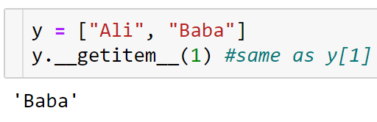
Built-in Function overloading
To change the default behavior of built-in functions, we need to define the corresponding special method in our class.

Slide 18
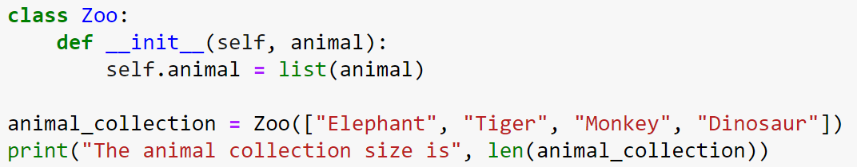
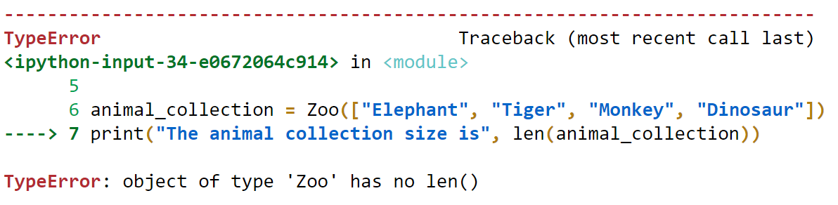
Type error with built-in functions

Slide 19
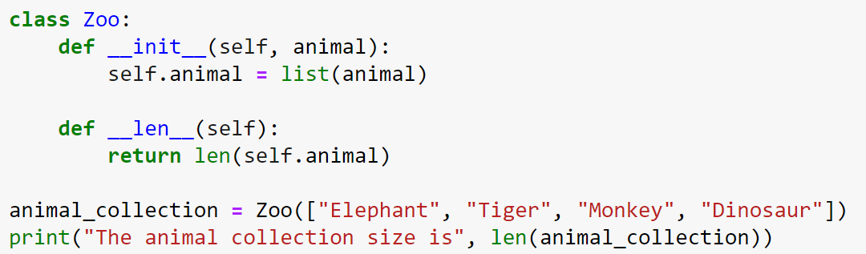
Overloading len() with __len__()
To change how the len() function behaves, we defined a special method called __len__() in our class

Slide 20
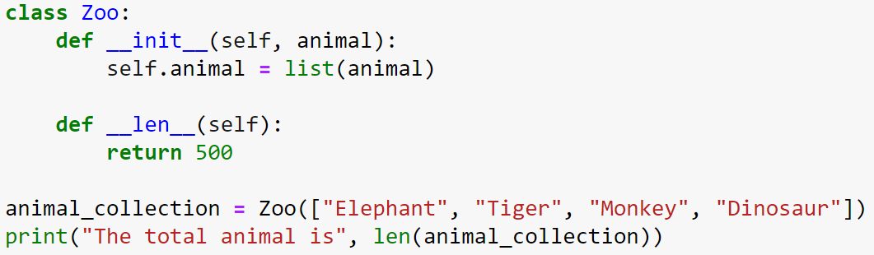

Overloading len() with new behavior
We change the behavior of built-in function len()by returning a specified value

Slide 21
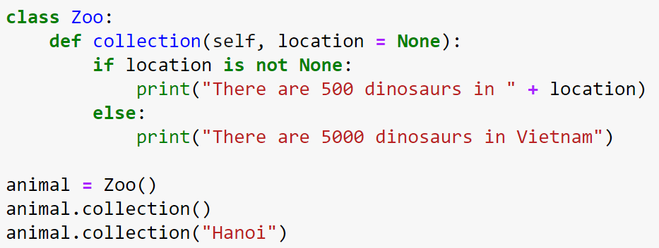

User-defined functions overloading
Function overloading with two implementations to call the function
Alternative way: *args and **kwargs

Slide 22
*args and **kwargs
*args and **kwargs are special keyword that allows the function to take the variable-length argument.
*args pass a variable number of non-keyworded arguments list and on which operation of the list can be performed.
**kwargs pass the variable number of keyword arguments dictionary to function on which operation of a dictionary can be performed.
*args and **kwargs make the function flexible.
[source]

Slide 23
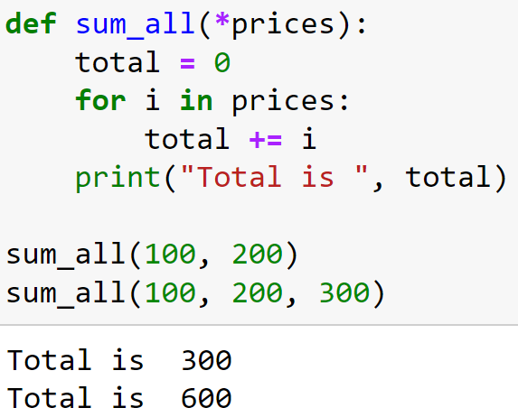
Python *args
*args: To pass the variable number of non keyword arguments to function

Slide 24
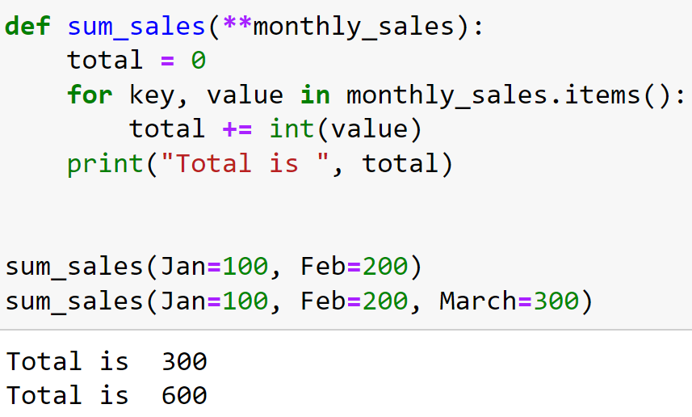
Python **kwargs
**kwargs: To pass the variable keyword arguments to function

Slide 25
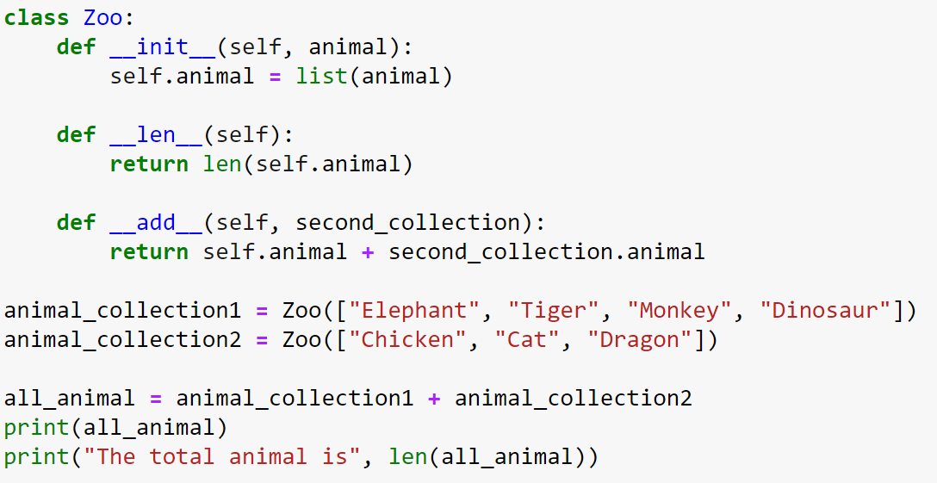
Complete the Zoo class for the given output!
Output:

Slide 26
encapsulation
Restrict access to methods and variables to prevent data from direct modification

Slide 27
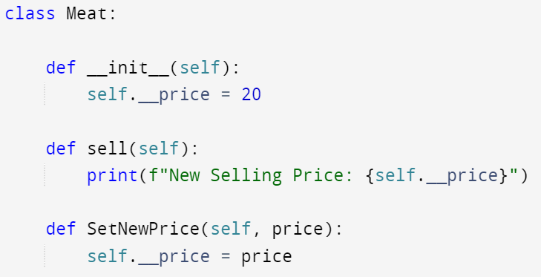
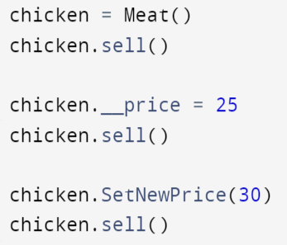
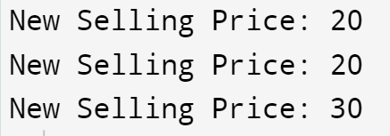
Encapsulation example
Private Attribute
(single _or double __)

Slide 28
polymorphism
Methods in child class have the same name as the methods in the parent class.
The child class modifies a method it has inherited from the parent class.

Slide 29
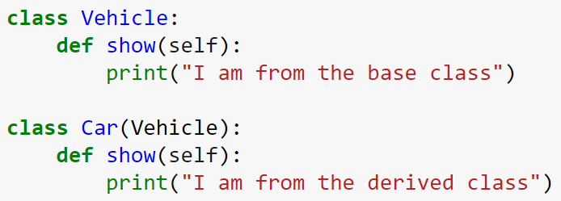



Overriding parent class methods
Overriding: to change the functional operation of a method defined in the base class.
The base class method is overridden by the derived class method.
Base Class
Derived Class

Slide 30
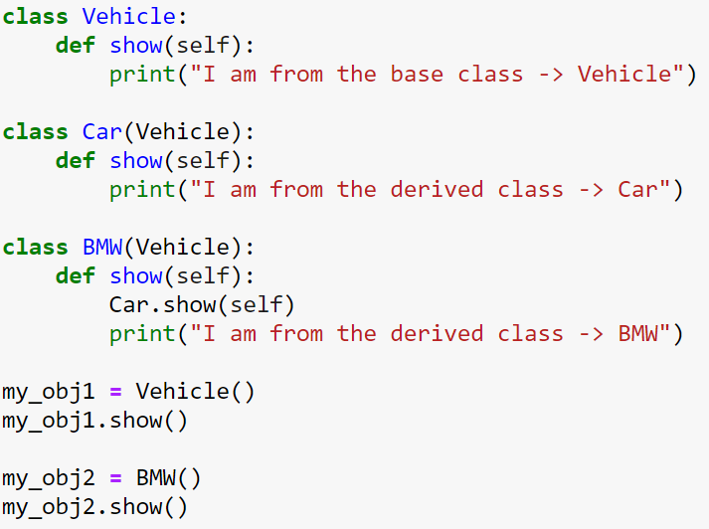

calling parent class methods

Slide 31
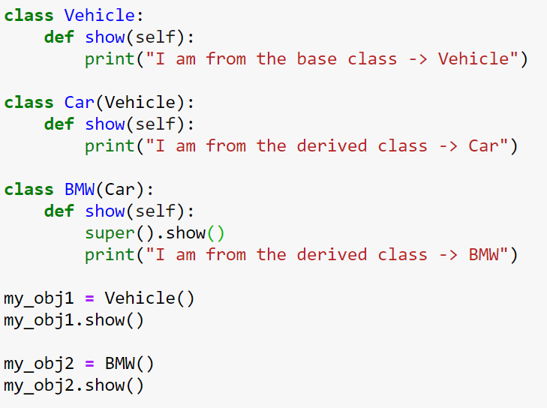
calling parent class methods

Slide 32
Quiz 3 (OOP)
Date: Nov 21, 2021
3.30 – 3.45 PM

